Slide 1

Bayesian Multivariate Gaussians for Biometric Profiling
Michael Wojnowicz
Notes:
Hierarchical,
OLD NOTES
Goal: Learn normal behavior. respond to deviations from normal.
Normal behavior varies by user
tailor model per user
need each user’s behavioral data
behavioral data are private and large
Solution:
(current) Behavior for each user is learned locally by unsupervised math models
(downstream) Hierarchical modeling

Slide 2
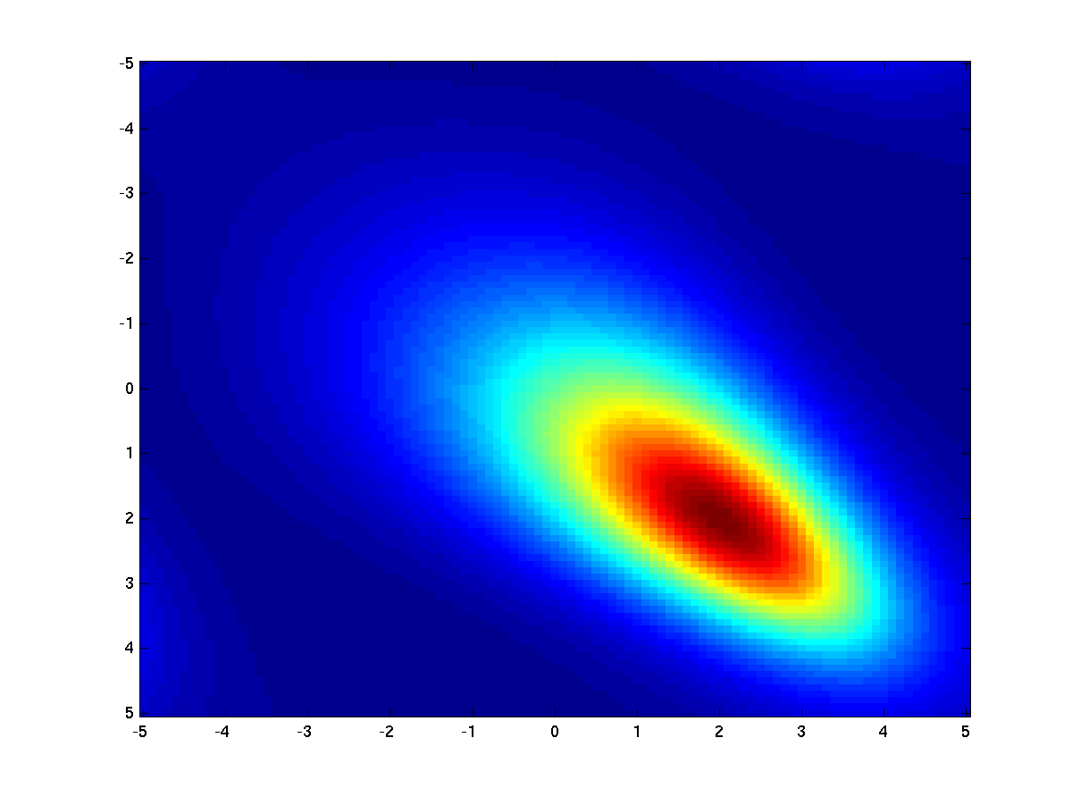
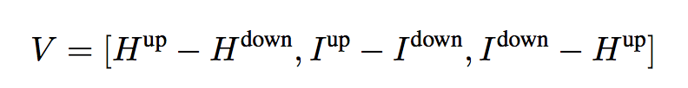
Keyboard Component
From typing to a trained user profile
Parse typing behavior as stream of bigrams
e.g. "HI AL" -> ("HI", "I[SPACEBAR]", "[SPACEBAR]A", "AL”)
Vectorize the bigrams into duration 3-vectors. For example, "HI” is represented as:
Train a model on these vectors.
Fit distribution of vectors with a Bayesian multivariate normal.
Train separate models for each bigram
Can be updated online
Notes:
RK: So you’re in this multivariate space, and observations becomes less likely as you move out from the mean in hyperellipses (isocontours/ isodensities).
Connect to anomaly detection – intrusion detection.

Slide 3
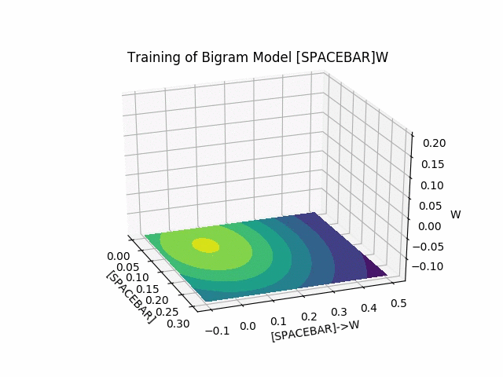
Keyboard Component
Training process: An illustration
Notes:
Q: What assumptions do you notice about the prior?

Slide 4
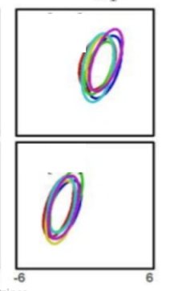
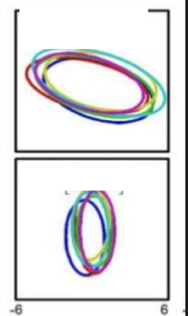
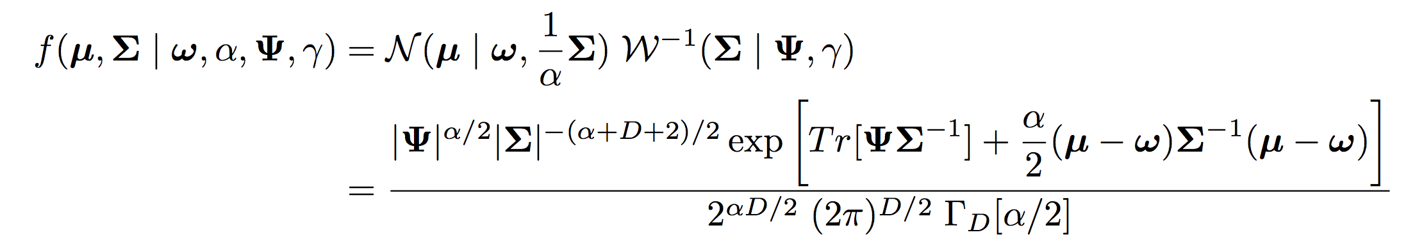
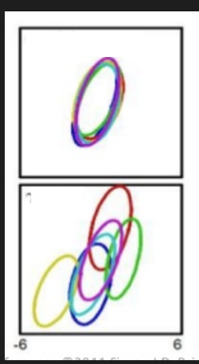
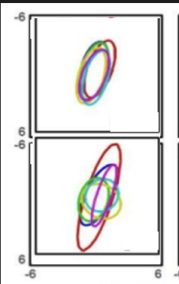
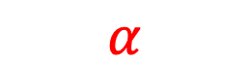
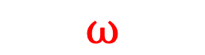
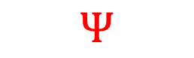
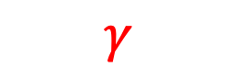
Normal Inverse Wishart (NIW) Distribution
A distribution over Multivariate Gaussians
Samples
$$Ψ$$
$$ω$$
Density
$$α$$
$$γ$$
Why bother?
Notes:
Goal
What is a Bayesian model in this case? And why use it?
What
Q: What is a sample here?
Why
Q: What would a good prior be?
NOTES
Inverse wishart is a distribution over real positive definite matrices (so covariance matrices)
Posterior asymptotically concentrates around maximum likelihood (ML) solution
But ML estimates of (high-dim) covariance matrices have large variance
Spherical prior provides regularization

Slide 5
Normal Inverse Wishart (NIW) Distribution
A distribution over Multivariate Gaussians
Samples
$$Ψ$$
$$ω$$
Density
$$α$$
$$γ$$
Notes
ML estimates of (high-dim) covariance matrices have large variance
Spherical prior provides regularization
Posterior asymptotically concentrates around maximum likelihood (ML) solution
Notes:
Goal
What is a Bayesian model in this case? And why use it?
What
Q: What is a sample here?
Why
Q: What would a good prior be?
NOTES
Inverse wishart is a distribution over real positive definite matrices (so covariance matrices)
Posterior asymptotically concentrates around maximum likelihood (ML) solution
But ML estimates of (high-dim) covariance matrices have large variance
Spherical prior provides regularization

Slide 6
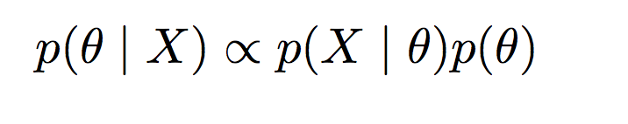
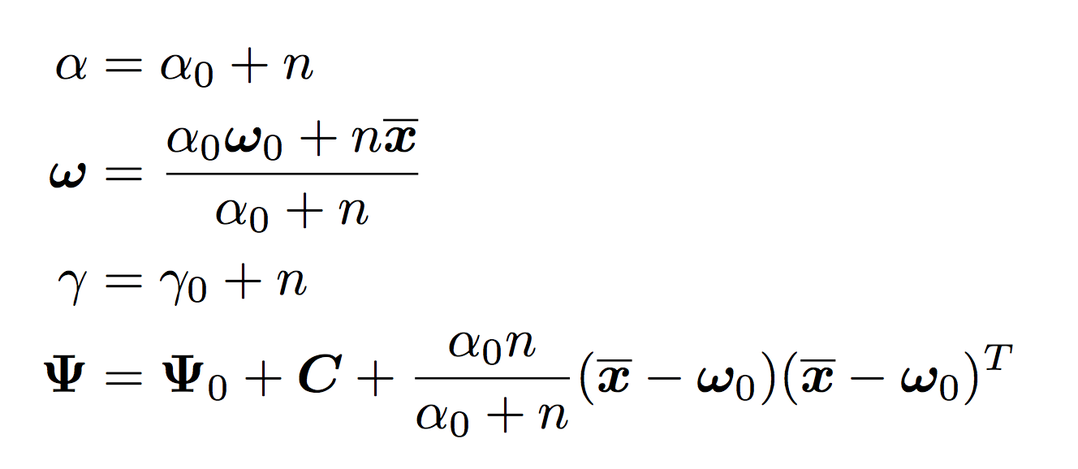
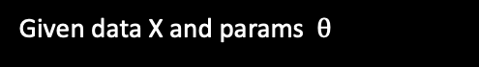
Normal Inverse Wishart (NIW)
A conjugate prior distribution
Conjugate prior
Given data X and params $θ$
_______Posterior
________Likelihood
____
Prior
NIW
MVN
NIW
Conjugate updates (to hyperparameters)
So what?
Notes:
Inverse wishart is a distribution over real positive definite matrices (so covariance matrices)

Slide 7
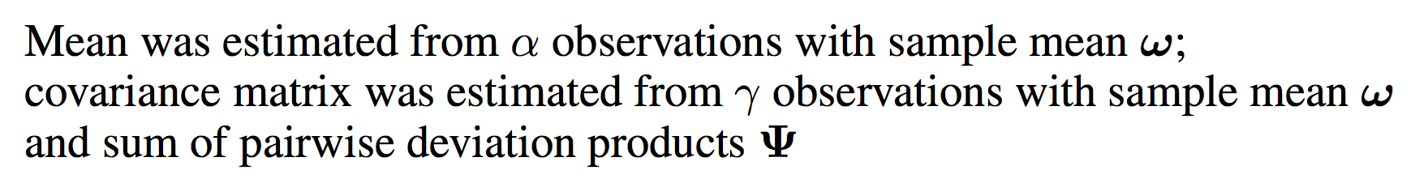
Normal Inverse Wishart (NIW)
A conjugate prior distribution
Conjugate prior
Given data X and params $θ$
_______Posterior
________Likelihood
____
Prior
NIW
MVN
NIW
Conjugate updates (to hyperparameters)
Notes
Easy, cheap updates
Supports online learning
Fits nicely in more complex models
Nice hyperparameter interpretation
Interpretation
Notes:
Inverse wishart is a distribution over real positive definite matrices (so covariance matrices)

Slide 8
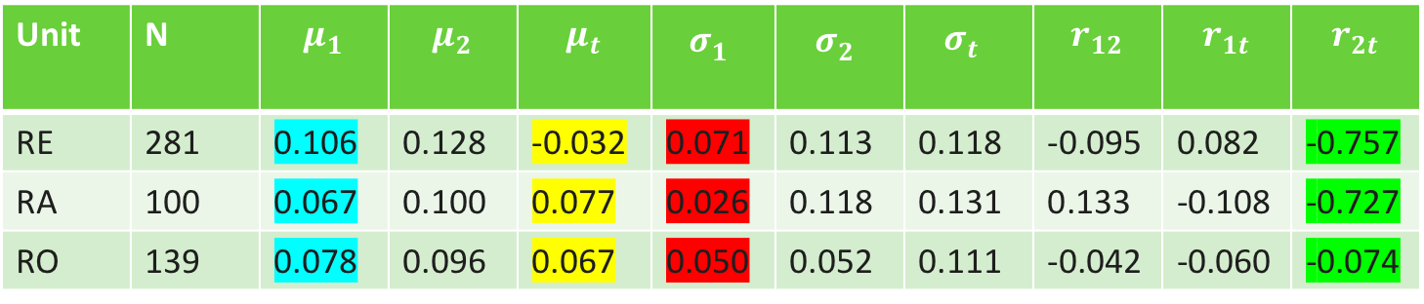
Keyboard Component
Trained user profile: What information is contained in "probabilistic bigrams"?
Unit | N | $$μ_{1}$$ | $$μ_{2}$$ | $$μ_{t}$$ | $$σ_{1}^{}$$ | $$σ_{2}^{}$$ | $$σ_{t}^{}$$ | $$r_{12}$$ | $$r_{1t}$$ | $$r_{2t}$$
RE | 281 | 0.106 | 0.128 | -0.032 | 0.071 | 0.113 | 0.118 | -0.095 | 0.082 | -0.757
RA | 100 | 0.067 | 0.100 | 0.077 | 0.026 | 0.118 | 0.131 | 0.133 | -0.108 | -0.727
RO | 139 | 0.078 | 0.096 | 0.067 | 0.050 | 0.052 | 0.111 | -0.042 | -0.060 | -0.074
Key:
1: 1st char
2: 2nd char
t: transition
Context-dependent means: R is slower when followed by E than A or O.
Transitions: Usually start E before R is done. Not true for RA or RO.
Context-dependent variances: R is more variable when followed by E than A or O.
Correlations: When the transition to E or A (but not O) is slower than usual, the press time of the second character is very likely to be faster than usual.
Why are the green values different? -> I am a hunt-and-pecker
Notes:
Trained user profile: how this different than typical bigrams (state of the art):-
-- red: so a really slow R followed by an A more unusual than a really slow R followed by an E or O.
-- This goes beyond Roy Maxion's state-of-the-art, which using non-probabilistic n-grams, and so can't decompose n-grams into contituent pieces to get context-dependent info, or correlation info.
Scoring
-- All this info is collapsed into a single score.
Now in multidimensional space, not clear what the “tail” is. Draw a circle? Rectangle? Square? Ellipse?
As it turns out, we can form generalized mahalanobis distances even in this context (noncentral t, not normal).
M.D. is closely related to PCA…. Penalize more for variation along non-dominant principal directions ("correlation breaking")
-- Distribution of MD's is known; thus can report scores in [0,1].

Slide 9
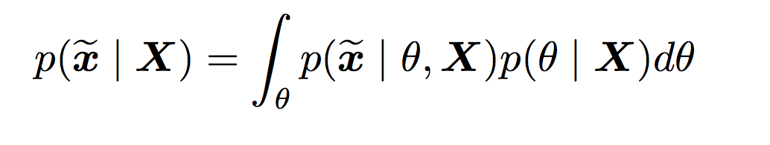
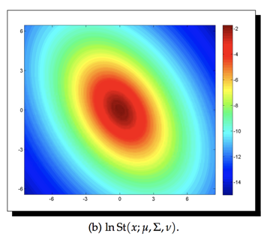
Keyboard Component:
Scoring new bigrams
Bayesian model averaging: Our predictions use the mean likelihood across infinitely many models, each weighted by our posterior belief in them.
Posterior
Predictive
template
_______
Post. Pred.
____________
Likelihood
_______
Posterior
Here we get a non-central multivariate T distribution
Notes:
Mahalanobis Distance:
Closely related to PCA. Penalize more for movement along non-dominant principal directions ("correlation breaking")
Take home:
Scores are probabilities, and so live in [0,1].
All information of user profile (previous slide) can be collapsed into a single score.
Scoring
-- All this info is collapsed into a single score.
Now in multidimensional space, not clear what the “tail” is. Draw a circle? Rectangle? Square? Ellipse?
As it turns out, we can form generalized mahalanobis distances even in this context (noncentral t, not normal).
M.D. is closely related to PCA…. Penalize more for variation along non-dominant principal directions ("correlation breaking")
-- Distribution of MD's is known; thus can report scores in [0,1].

Slide 10
Keyboard Component:
Scoring new bigrams
Posterior
Predictive
template
_______
Post. Pred.
____________
Likelihood
_______
Posterior
Here we get a non-central multivariate T distribution
But still, how do we use this to score new data?
Notes:
Mahalanobis Distance:
Closely related to PCA. Penalize more for movement along non-dominant principal directions ("correlation breaking")
Take home:
Scores are probabilities, and so live in [0,1].
All information of user profile (previous slide) can be collapsed into a single score.
Scoring
-- All this info is collapsed into a single score.
Now in multidimensional space, not clear what the “tail” is. Draw a circle? Rectangle? Square? Ellipse?
As it turns out, we can form generalized mahalanobis distances even in this context (noncentral t, not normal).
M.D. is closely related to PCA…. Penalize more for variation along non-dominant principal directions ("correlation breaking")
-- Distribution of MD's is known; thus can report scores in [0,1].

Slide 11
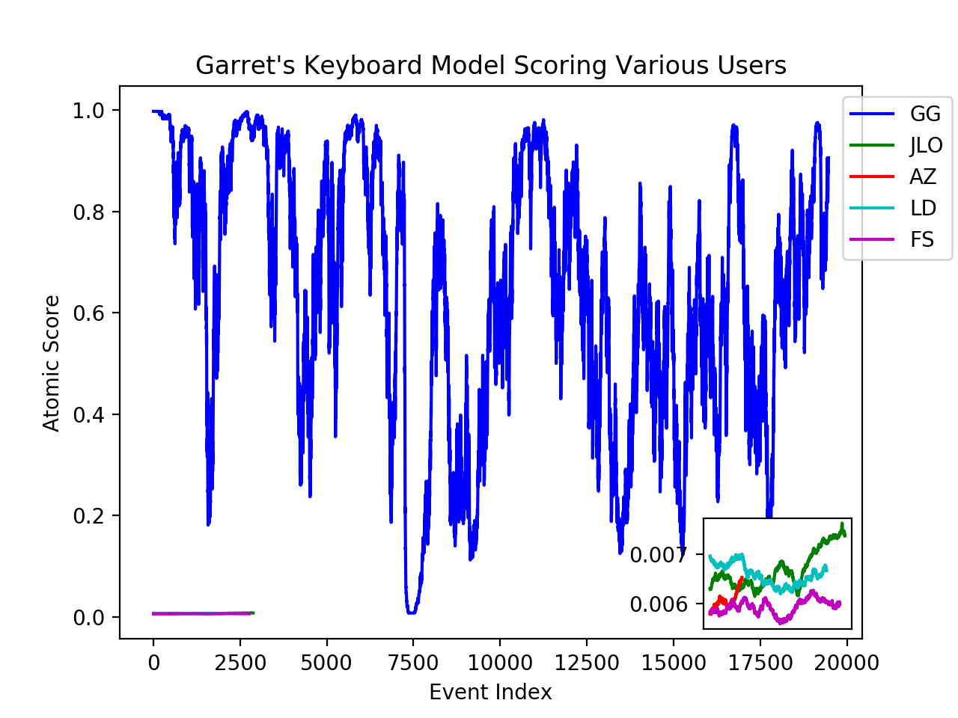
Keyboard Component
Imagine someone else is sitting and typing at your computer….
Hypothesis:
User A's profile should score User A's own typing more highly than User B's typing.
Method:
Take a user (here, Garret)’s trained keystrokes model..
Apply Garret’s model to a hold-out test set of typing from Garret, Jeff, Arthur, and some others.

